Slide 1

Process Mining Virtual Internship
by
C.RUPA SREE
Roll No. 214G1A3288
Department of Computer Science and Engineering (Data Science)
Srinivasa Ramanujan Institute of Technology
(Affiliated to JNTUA & Approved by AICTE) (Accredited by NAAC with ‘A’ Grade & Accredited by NBA (EEE, ECE & CSE)
Rotarypuram Village, B K Samudram Mandal, Ananthapuramu – 515701.
2023 - 2024

Slide 2
Contents
Course Objective
Introduction
Technology
Applications
Modules
Real Time applications
Learning outcomes
GitHub Link
Queries

Slide 3
Course Objective
The Course analysis a Key techniques in Process Mining.
Process mining applies data science to discover, validate and improve workflows.

Slide 4
Introduction
Process mining is a data-driven approach to understanding, analyzing, and improving business processes within an organization. It leverages data from various sources, such as event logs, to create visual representations of processes, identify inefficiencies, and suggest optimizations. By analyzing these data-driven process models, organizations can gain insights into how their processes actually work, as opposed to how they are supposed to work on paper. This allows for better decision-making, enhanced process efficiency, and the identification of opportunities for automation and improvement.
Process mining is a powerful approach that combines data analytics, visualization, and process management to help organizations gain a deeper understanding of their operational processes. It facilitates the identification of inefficiencies, compliance issues, and improvement opportunities,ultimately leading to more efficient, effective, and adaptable business processes.

Slide 5
Continued…
What is Process Mining?
What is Process?
A process is very simply a series of linked actions or steps taken in order to achieve a particular end. For customer service, these could be the steps to resolve a ticket.
For sales, it could be the steps to progress an opportunity from a lead to closure.
Take order management, for example. This could be the steps from a customer ordering goods, to you shipping, and then ultimately getting paid for them. You get the point.
Process Mining is the combination of two disciplines: Data Science and Business Process Management. Process Mining essentially uses Data Science techniques, such as Big Data and AI, to Process Mining virtual Internship address Process Science problems such as process improvement and automation (cf. van der Aalst 2016).

Slide 6
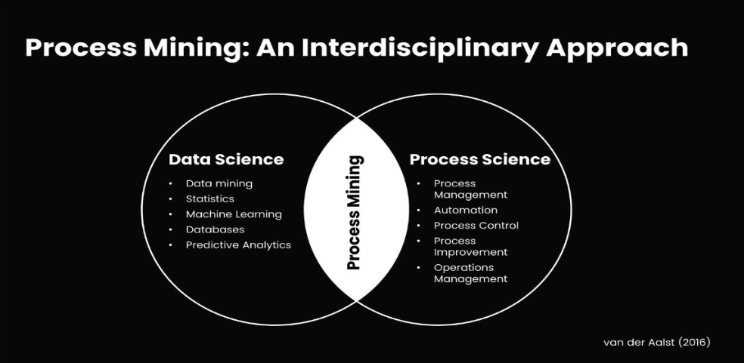
Continued…

Slide 7
Continued…
Digital Footprint
A digital footprint – sometimes called a digital shadow or an electronic footprint – refers to the trail of data you leave when using the internet.
Process Mining achieves this union by taking the digital footprints that are created in IT systems and using them to reconstruct and visualize process flows. From here, Process Mining technology can identify patterns and deviations and ultimately eliminate bottlenecks. A digital footprint grows in many ways – for example, posting on social media, subscribing to a newsletter, leaving an online review, or shopping online.
Sometimes, it’s not always obvious that you are contributing to your digital footprint. For example, websites can track your activity by installing cookies on your device, and apps can collate your data without you knowing it. Once you allow an organization to access your information, they could sell or share your data with third parties. Worse still, your personal information could be compromised as part of a data breach.

Slide 8

Continued…
Event logs
Event logs are the format in which we can retrieve our digital footprints from the underlying IT systems. They're essentially the log books that IT systems keep to record what events take place for each Case ID and at what time.

Slide 9
Continued…
Event logs are commonly found in operating systems (such as Windows Event Logs and Linux Syslog), networking equipment, applications, databases, and other software systems. They help administrators and analysts understand the history of a system's behavior and diagnose issues by identifying patterns, anomalies, and errors.
Key features of event logs include:
1.Case ID:a unique identifier such as a purchase order item, invoice number or order number.
2.An Activity:he description of what has happened - for example, the creation of a purchase order or the receipt of goods.
3.Timestamp: the date and time that the activity took place.

Slide 10
Technology
Technology plays a crucial role in process mining, which is a discipline within the field of business process management that focuses on discovering, monitoring, and improving business processes using data from various information systems. Process mining leverages technology to extract valuable insights from event logs and other data sources to understand how processes are actually executed within an organization. Here's how technology is involved in the process mining process:
1.Data Extraction and Collection:It is used to extract relevant data from various sources such as enterprise systems, databases, transaction logs, and more. This data is then collected and consolidated for analysis.
2.Data Processing:Raw event data often needs to be preprocessed to clean and transform it into a suitable format for analysis. Technology tools are used to remove duplicates, handle missing data, and standardize data formats.

Slide 11
Continued…
3.Processing Discovery:Process discovery involves using technology to analyze event logs and automatically generate process models, such as process flowcharts or process maps.
4.Machine Learning And AI: Advanced process mining solutions may incorporate machine learning and AI techniques to improve the accuracy of process discovery, predict process behavior, and provide more sophisticated insights
5.Data Visualization: Technology tools are used to create visual representations of process data and analysis results. Interactive dashboards and visualizations help stakeholders understand complex insights and make data-driven decisions.
Overall, technology is the foundation of process mining, enabling organizations to gain actionable insights from their operational data and drive continuous process improvement.

Slide 12
Applications:
Process mining is a data-driven technique that involves analyzing event logs to extract insights and discover patterns from business processes. It has a wide range of applications across various industries. Some common applications of process mining include:
Process Discovery: Process mining can be used to automatically generate process models based on the event logs from various IT systems. This helps organizations understand how processes are actually executed and identify deviations from expected behavior.
Process Conformance Checking: Organizations can compare the actual execution of processes with the intended process models to identify discrepancies and non-compliant activities. This helps in improving process adherence and compliance.
Fraud Detection: By analyzing patterns of behavior in event logs, process mining can help identify anomalous activities that may indicate fraudulent behaviour.

Slide 13
Modules:
Fundamentals of Process Mining:
Modules in process mining refer to distinct areas or topics of study within the field. These modules help break down the comprehensive study of process mining into manageable segments, allowing learners to delve deeper into specific aspects.
1.Review of Interpret Analysis: "Review and Interpret Analyses" in the context of process mining refers to the essential skill of critically evaluating the results of various analyses performed on event log data. This skill is crucial for extracting meaningful insights and making informed decisions regarding process optimization and improvement.
What is an Variant Explorer?
The Variant Explorer is a tool within Celonis that allows users to analyze and visualize different variants or paths that process instances take through a process flow. In many business processes, there are multiple ways a process can be executed based on different conditions, exceptions, or decisions made during the process.

Slide 14
Continued…
What is an Process Explorer?
The process Explorer is another analysis tool to use when taking an exploratory approach. It's especially useful for quickly revealing activities beyond the most common ones. It also allows you to narrow your focus on a single activity, for example an undesired activity, to see which activities cases typically come from and which activities they're going to.Celonis Process Explorer is a component within the Celonis platform that allows users to:
Visualize Process:It provides visual representations of processes based on event data. These visualizations include process maps, flowcharts, and diagrams that illustrate the flow of activities and paths taken by process instances.
Explorer Variants:Users can explore different variants or paths that process instances follow.This helps identify common patterns, exceptions, and variations in process execution.

Slide 15
Continued…
2.Build Analyses:
"Build analysis" in process mining refers to constructing detailed examinations of event log data to uncover insights about business processes. This involves creating visual representations and utilizing tools to identify patterns, exceptions, and areas for improvement,aiding in making informed decisions for process optimization.

Slide 16
Continued…
3.Case Study:
A case study in process mining involves applying process mining techniques to real-world data from a specific business process. It aims to understand the process, identify issues, and propose improvements for better operational efficiency.
Data Collection: Gather data from the pizzeria's systems capturing order taking, preparation, cooking, and delivery times.
Process Visualization: Create visual representations of the pizzeria's processes, showing how orders move from start to finish.

Slide 17
Continued…
Rising star Technical:
"Rising star" is a term often used to describe individuals who are on a trajectory of rapid growth, development, and success in their field or career. In the context of "Rising star Technical in process mining," it refers to someone who is quickly emerging as a skilled and influential professional in the technical aspects of process miningIt mainly consists of Two pats:
1.Write PQL Queries
2.Get Data into the EMS
Write PQL Queries:
Writing Process Query Language (PQL) queries in process mining involves creating specific queries to extract insights and information from event log data. PQL is a query language designed to interact with event logs and process models, enabling users to retrieve relevant process information for analysis.

Slide 18
Continued…
Case:The case attribute indicates which process instance the event belongs to. A process instance is called a case, usually consisting of multiple events.
Activity: The activity attribute describes the action that is captured by the event.
In our food delivery example, these are all the steps an order has passed through, from r receiving the order, to cooking the meal, delivery and payment.
Timestamp:Each activity leaves a digital footprint with a timestamp, indicating precisely when each event took place.
Get Data Into the EMS:
In process mining, "EMS" could refer to "Event Management System" or another specific context related to process mining tools or platforms. If you're referring to an Event Management System, the process of getting data into it for process mining analysis involves collecting and storing event log data from various sources. Here's an explanation of how data is typically collected and integrated into an Event Management System for process mining:

Slide 19
Continued..
Data Extraction: Involves retrieving relevant event data from the sources. This could be done using various methods, including APIs, direct database queries, log file parsing, or data connectors provided by process mining tools.
Data Transferring and Cleansing: The extracted data might be in different formats and structures. Data transformation involves converting the data into a consistent format suitable for process mining analysis. This step might also include cleansing the data to remove inconsistencies, duplicates, and irrelevant information.

Slide 20
Real Time Examples
Process mining involves analyzing event logs to gain insights into business processes. Here are some examples of how process mining can be applied across different industries and domains:
1.Healthcare:
Patient Journey Analysis: Studying patient data to understand the flow of patients through different departments, identifying delays, and improving resource allocation for better patient care.
Claim Processing: Analyzing insurance claims processing to identify inefficiencies, reduce processing times, and ensure accurate billing.
2.Logistics:
Shipment Tracking: Analyzing data from tracking systems to visualize the movement of shipments, identify potential delays, and improve delivery accuracy.
Route Optimization: Studying vehicle movement data to optimize delivery routes, reduce fuel consumption, and improve overall fleet efficiency.

Slide 21
Continued…
Manufacturing: Process mining can be applied to analyze production processes and identify areas for improvement. It can help optimize production cycles, reduce waste, and enhance overall operational efficiency.
Customer Service: Process mining can be applied to analyze customer service processes, such as call handling or complaint resolution. It can help identify areas for improvement, optimize response times, and enhance customer satisfaction.
Root Cause Analysis: Process mining techniques can identify the root causes of process inefficiencies or deviations by analyzing event data.This helps organizations pinpoint the underlying issues and take targeted actions to address them.
Process Enhancement: Based on process mining insights, organizations can redesign and optimize their processes to eliminate bottlenecks, reduce costs, and improve customer satisfaction.

Slide 22
Learning Outcomes
Understand what is process mining and the basics and how it works.
Understanding how process mining helps in Business world.
you will learn how to extract and create visual representations of processes and to take decision making and process improvement efforts.
Process mining can help ensure compliance with regulations and internal policies by identifying deviations and non-compliances in process execution.
Analyzing variant explorer and process explorer process performance metrics and KPIs.
Summarize what an event log is and why we need in Process Mining.
You will gain skills in using process mining tools and interpreting the results to enhance organizational efficiency and effectiveness.
Predicting process outcomes and future behaviour.
After completing this course you will learn about process query language.
Understanding process behaviour and it’s applications in daily life.
Navigate and effectively utilize process mining tools and software applications.
.

Slide 23
Any Queries?

Slide 24
Thank You!!!

